Slide 1

MNIST Digit Classification Project
A comprehensive implementation of a neural network for handwritten digit recognition using TensorFlow/Keras and the MNIST dataset
Made by ADITI

Slide 2
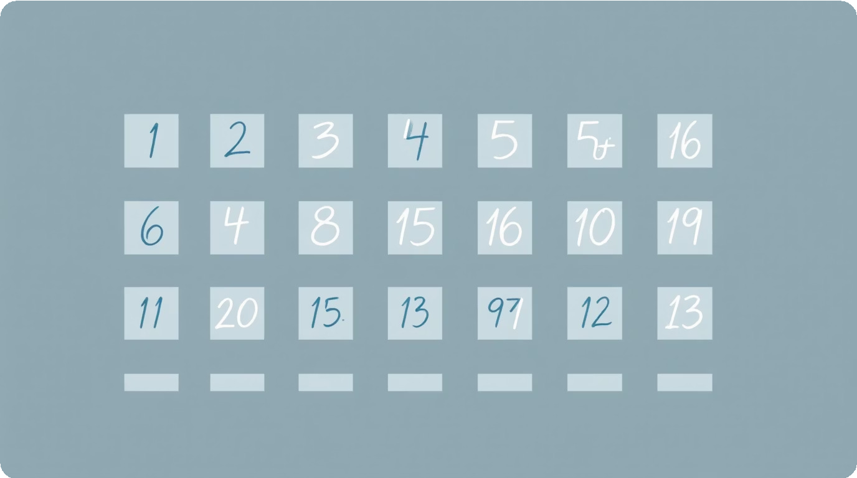
Executive Summary
Project Objective
Build, train, and evaluate a neural network capable of classifying handwritten digits from the MNIST dataset, then test on custom user-provided images.
Key Achievements
97.5% test accuracy (exceeding 90% target)
Successfully predicted custom image as digit 3
Robust 98.8% training accuracy

Slide 3
Dataset Overview
60K
Training Imagcs Handwritten digits for model training
f0K
Tcs” Imagcs
Unseen digits for evaluation
2S×2S
Imagc Dimcnsions
Grayscale pixels per image
f0
Classcs
Digits 0 through 9
The MNIST dataset is loaded directly using keras.datasets.mnist, providing a perfect split between training and test sets for reliable model evaluation.

Slide 4

Neural Network Architecture
0!
Input Layer
Flatten layer converts 28×28 2D images into 1D array of 784 neurons
02
Hidden Layer f
Dense layer with 128 neurons using ReLU activation for pattern recognition
03
Hidden Layer 2
Dense layer with 64 neurons using ReLU activation for deeper feature extraction
0h
Output Layer
Dense layer with 10 neurons using Softmax activation for class probabilities

Slide 5

Model Compilation & Training
Compilation Configuration
Optimizer: Adam (adaptive moment estimation) Loss Function: Sparse categorical crossentropy Metrics: Accuracy tracking
Training Parameters
Model trained over 5 epochs with 60,000 training images. The training showed rapid convergence with loss decreasing from 0.2435 to 0.0379.

Slide 6



Training Performance
S.S%
7.5%
0.037
Training Ẩccnracy
Final accuracy on training set
Tcs” Ẩccnracy
Accuracy on unseen test data
Training Woss
Final loss value after training
The model demonstrated excellent convergence with healthy loss reduction and consistent accuracy improvement across all 5 epochs.

Slide 7
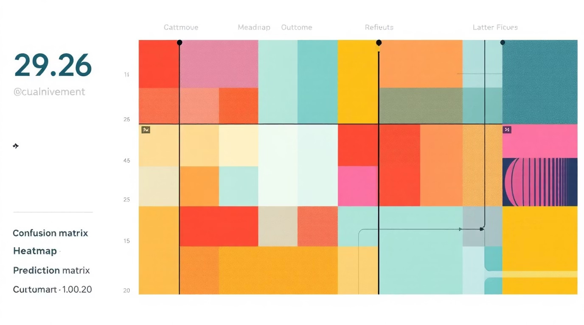
Model Evaluation Results
Evaluation Methodology
The model was tested against 10,000 unseen test images to assess real-world viability. A confusion matrix was generated using Seaborn to visualize true positives versus false positives.
Performance Summary
The evaluation yielded 97.5% test accuracy, significantly exceeding the 90% target. This indicates strong generalization capability and minimal overfitting.

Slide 8
Custom Image Prediction Pipeline
Imagc Woading
OpenCV loads 3-digit.PNG file
f
Črayscalc Conucrsion
Image converted to single channel
2
Rcsixing
Scaled to 28×28 pixels
3
Normalixa”ion
Pixel values scaled 0-1
h
Wrcdic”ion
Model outputs probabilities
5
The preprocessing pipeline ensures custom images match the training data format. np.argmax() identifies the highest probability class, producing the final prediction.

Slide 9
Results vs. Expectations
Metric | Expected Target | Actual Achieved | Status
Model Accuracy | >90% | 97.5% | 7 Exceeded
Custom Prediction | Correct digit | Digit 3 7 | 7 Passed
Training Convergence | Rapid loss decrease | 0.2435K0.0379 | 7 Successful

Slide 10
Future Improvements & Extensions
Data Augmentation
Rotate, shift, and scale digits to improve robustness
Generate synthetic samples to balance class distributions
Research Directions
Compare performance with transformer-based
models
Extend to multi-digit recognition tasks
Regularization Enhancements
Add Dropout layers to reduce overfitting
Experiment with L2 weight regularization
Advanced Architectures
Implement Convolutional Neural Networks (CNNs) for spatial feature extraction
Explore Residual Networks (ResNets) for deeper learning

Slide 11


Conclusion & Key Takeaways
Target Exceeded
97.5% accuracy surpasses 90% goal with strong generalization
Effective Architecture
Dual hidden layers provide excellent pattern recognition capacity
Production Ready Successfully processes custom images with accurate predictions
This implementation demonstrates a complete neural network pipeline from data loading through model evaluation. The architecture balances complexity with performance, achieving excellent accuracy while maintaining training efficiency. Future improvements could explore dropout for regularization or convolutional layers for enhanced feature extraction.

